Slide 1
HBase

Slide 2
What is Apache Hbase?
HBase is a distributed column-oriented database built on top of the
Hadoop file system. It is an open-source project and is horizontally
scalable.
HBase is a data model that is similar to Google’s big table designed to provide quick random access to huge amounts of structured data. It leverages the fault tolerance provided by the Hadoop File System (HDFS).
It is a part of the Hadoop ecosystem that provides random real-time read/write access to data in the Hadoop File System.
One can store the data in HDFS either directly or through HBase. Data consumer reads/accesses the data in HDFS randomly using HBase. HBase sits on top of the Hadoop File System and provides read and write access.

Slide 3
Features of Apache Hbase
Some of the more important features include the following capabilities:
Linear and modular capabilities
Strictly consistent reads and writes
Automatic and configurable sharding of tables
Automatic failover support between RegionServers
Convenient base classes for backing Hadoop MapReduce jobs with Apache Hbase tables
Easy-to-use Java API for client access

Slide 4
Limitations of Hadoop
Hadoop can perform only batch processing, and data will be accessed only
even for the simplest of jobs.
A huge dataset when processed results in another huge data set, which should also be processed sequentially. At this point, a new solution is needed to access any point of data in a single unit of time (random access).
Applications such as HBase, Cassandra, couchDB, Dynamo, and MongoDB are some of the databases that store huge amounts of data and access the data in a random manner.
in a sequential manner. That means one has to search the entire dataset

Slide 5
Hbase Data Model Overview
A table in Hbase is similar to other databases, having rows and columns.
Column in Hbase are grouped into column families, all with the same
prefix.
For example, consider a table of daily stock prices.
There may be a column family called “price” that has four members – price:open, price:close, price:low and price:high
A column does not need to be a family.
For instance, the stock table may have a column named ‘volume’ indicating how many shares were traded.
All column family members are stores together in the physical file system.

Slide 6
Hbase Data Model Overview
Specific Hbase cell values are identified by row key, column (column family and
It is possible to have many versions of data within an Hbase cell.
A version is specified as a timestamp and is created each time data are written
to a cell.
Almost anything can serve as a row key, from strings to binary representations of longs to serialized data structures.
Rows are lexicographically sorted with the lowest order appearing first in a table.
The empty byte array denotes both the start and the end of a tables namespace.
All tables accesses are via the table row key, which is considered its primary key.
column), version (timestamp).

Slide 7
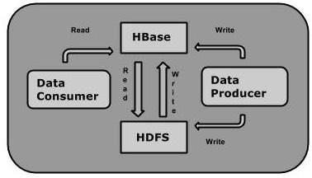
What is HBase?

Slide 8
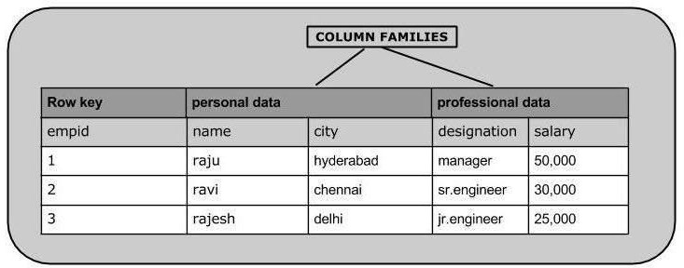
Storage Mechanism in HBase

Slide 9
Hbase Installation
Download
http://archive.apache.org/dist/hbase/0.98.24/
Extract
sudo tar -zxvf hbase-0.98.24-hadoop2-bin.tar.gz
Move
sudo mv hbase-0.98.24-hadoop2 /usr/local/Hbase
cd /usr/local/Hbase/
sudo gedit hbase-env.sh
– export JAVA_HOME=/usr/lib/jvm/java-8-openjdk-amd64
cd conf/
sudo gedit hbase-site.xml
cd /usr/local/Hbase/bin
Edit ~/.bashrc
./start-hbase.sh

Slide 10
Hbase Installation
<property>
•
<value>file:/usr/local/hadoop/HBase/HFiles</value>
</property>
<name>hbase.rootdir</name>
//Here you have to set the path where you want HBase to store its built in zookeeper files.
<property>
<name>hbase.zookeeper.property.dataDir</name>
<value>/usr/local/hadoop/zookeeper</value>
</property>

Slide 11
Hbase Example Walk-Through
To enter the hbase shell use the following command
– hbase shell
To exit the shell you can type exit
– hbase> exit
To know the system status use status command which gives the number of servers running and dead.
hbase> statues
4 servers, 0 dead, 1.000 average load

Slide 12
Hbase Example Walk-Through
Create Database and insert data
– create ‘apple’, ‘price’, ‘volume’
– In this case able name is apple and two columns are defined.
The price column is the family of four values (open, close, low and high)
put command is used to add data to the database within the shell.
put 'apple', '17-April-19', 'price:open', '125'
put 'apple', '17-April-19', 'price:high', '126'
put 'apple', '17-April-19', 'price:low', '124'
put 'apple', '17-April-19', 'price:close', '125.5'
put 'apple', '17-April-19', 'volume', '1000'

Slide 13
Hbase Example Walk-Through
Inspect Database
The entire database can be listed using the scan command.
scan 'apple'
ROW
17-April-19
17-April-19
17-April-19
17-April-19
17-April-19
COLUMN+CELL
column=price:close, timestamp=1555508855040, value=122.5 column=price:high, timestamp=1555508840180, value=126 column=price:low, timestamp=1555508846589, value=124 column=price:open, timestamp=1555508823773, value=125 column=volume:, timestamp=1555508892705, value=1000

Slide 14
Hbase Example Walk-Through
Get a row
You can use row key to access the individual rows.
get 'apple', '17-April-19'
COLUMN
price:close
price:high
price:low
price:open
volume:
CELL
timestamp=1555508855040, value=122.5 timestamp=1555508840180, value=126 timestamp=1555508846589, value=124 timestamp=1555508823773, value=125 timestamp=1555508892705, value=1000

Slide 15
Hbase Example Walk-Through
Get table Cell
get 'apple', '17-April-19', {COLUMN =>'price:low'}
COLUMN
price:low
CELL
timestamp=1555508846589, value=124
get 'apple', '17-April-19', {COLUMN => ['price:low', 'price:close']}
COLUMN
price:close
CELL
timestamp=1555508855040, value=122.5
•
price:low
timestamp=1555508846589, value=124

Slide 16
Hbase Example Walk-Through
Get table Cell
get 'apple', '17-April-19', { COLUMN=> ['volume', 'price:low']}
COLUMN
price:low
volume:
CELL
timestamp=1555508846589, value=124 timestamp=1555508892705, value=1000

Slide 17
Hbase Example Walk-Through
Delete Cell, Row and Table
delete 'apple', '17-April-19', 'price:low'
deleteall 'apple', '17-April-19'
disable 'apple'
drop 'apple'

Slide 18
Hbase Example Walk-Through
Scripting
echo "create 'apple', 'price', 'volume'"
echo "create 'apple', 'price', 'volume'" | hbase shell
Create test.sh file with contents
echo "create 'mango', 'price', 'volume'"
echo "put 'mango', ‘123’, 'price', '100'"
Then run the following commands
•
sudo sh test.sh | hbase shell

